Slide 1





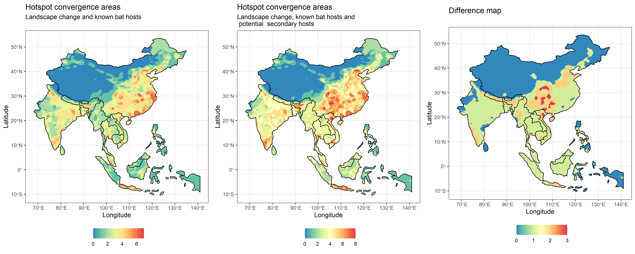
Figure 2
table(db$n_hotspots_risk2 - db$n_hotspots_risk1)
0 1 2 3
12093 10569 2816 318

Slide 2
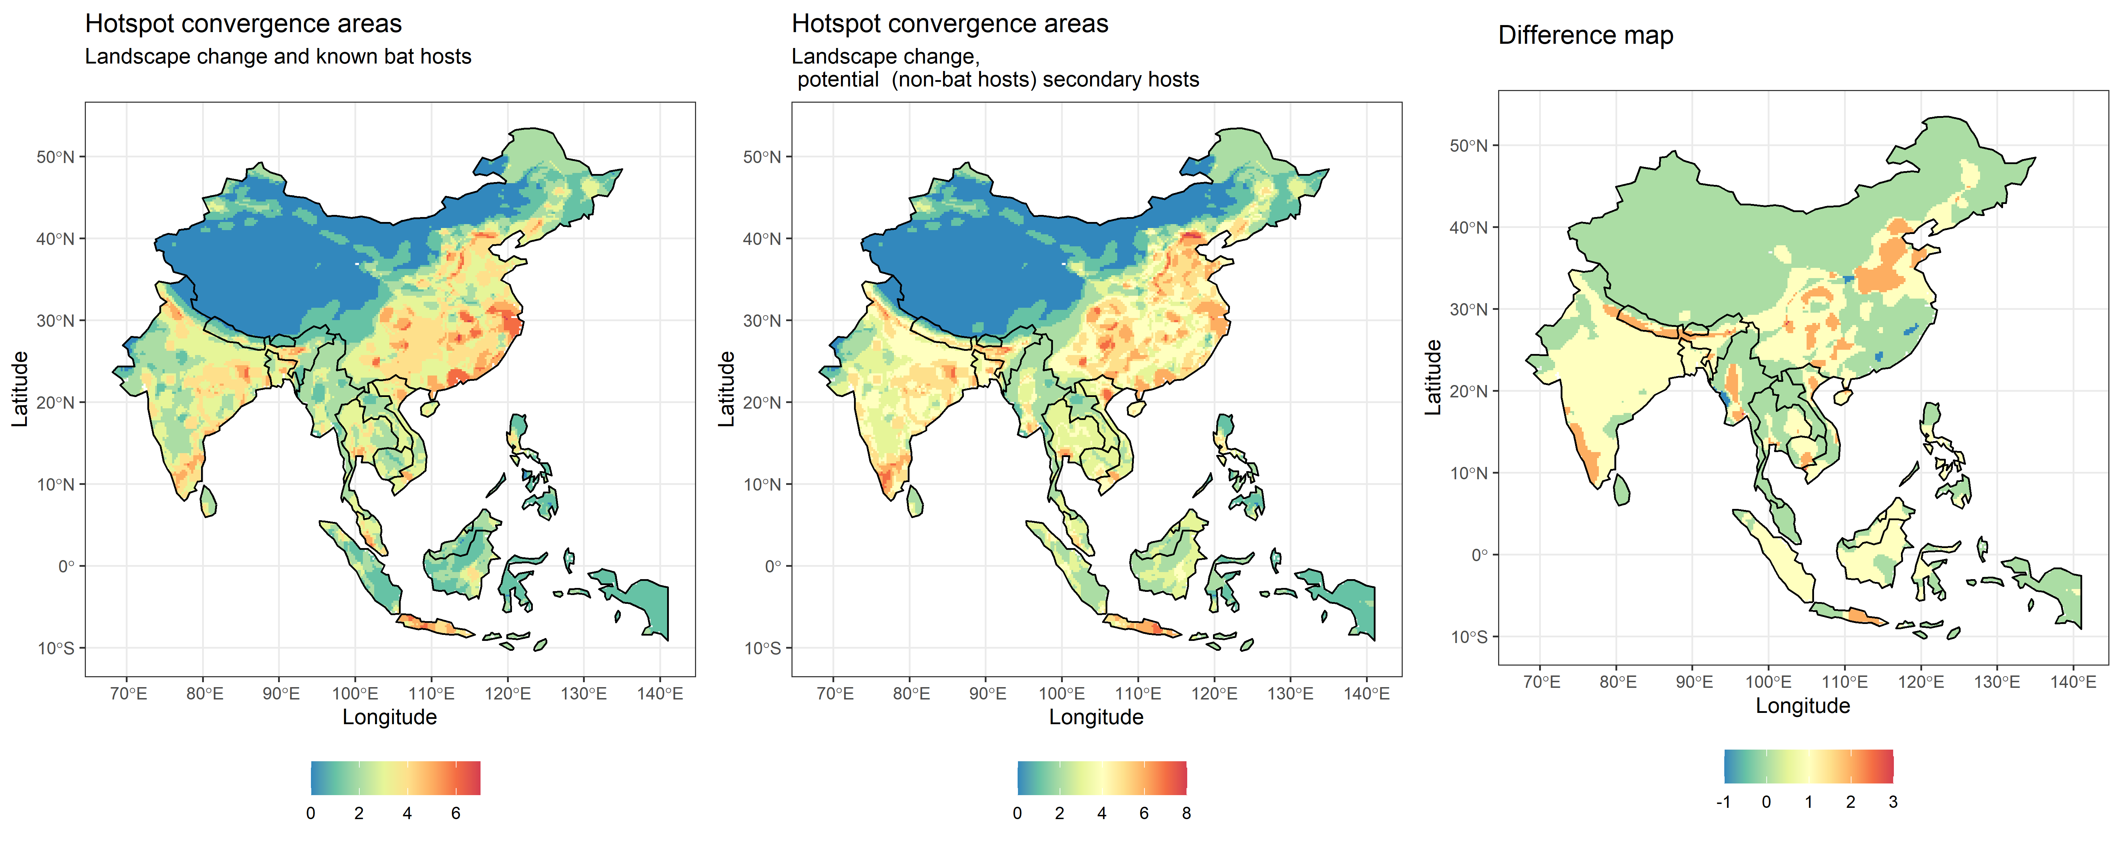
Figure 2
dif
-1 0 1 2 3
74 15908 8229 1580 5

Slide 3
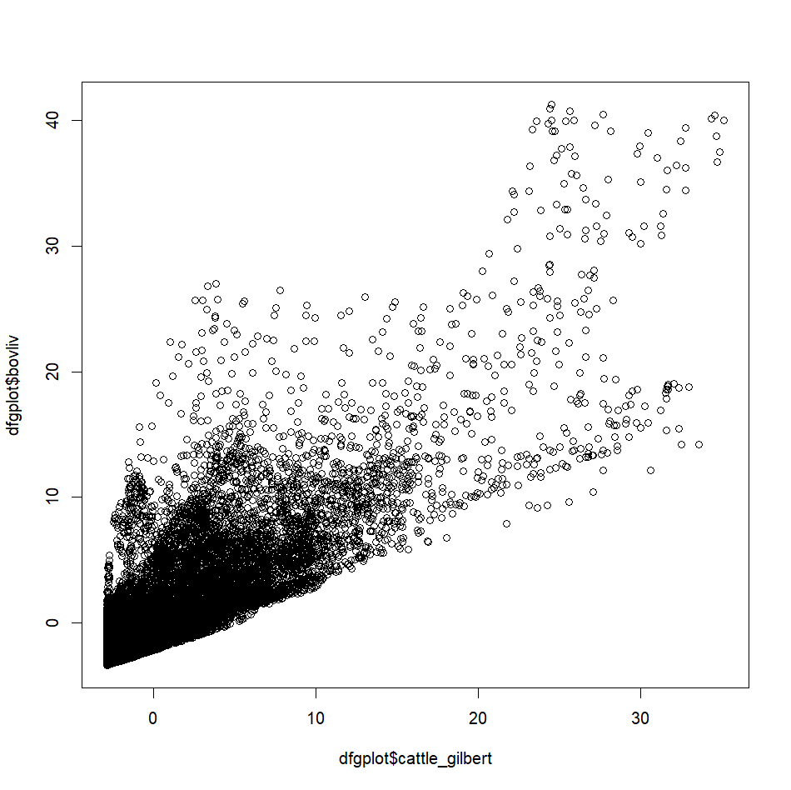
So apparently summing them makes the hotspots less intense, by spatially evenning out the values for livestock. This may be even more reallistic for hazard
> max(p$cattle_gilbert)
[1] 68677.8
> max(p$buffalo_cattle_goat_sheep)
[1] 104970.1

Slide 4

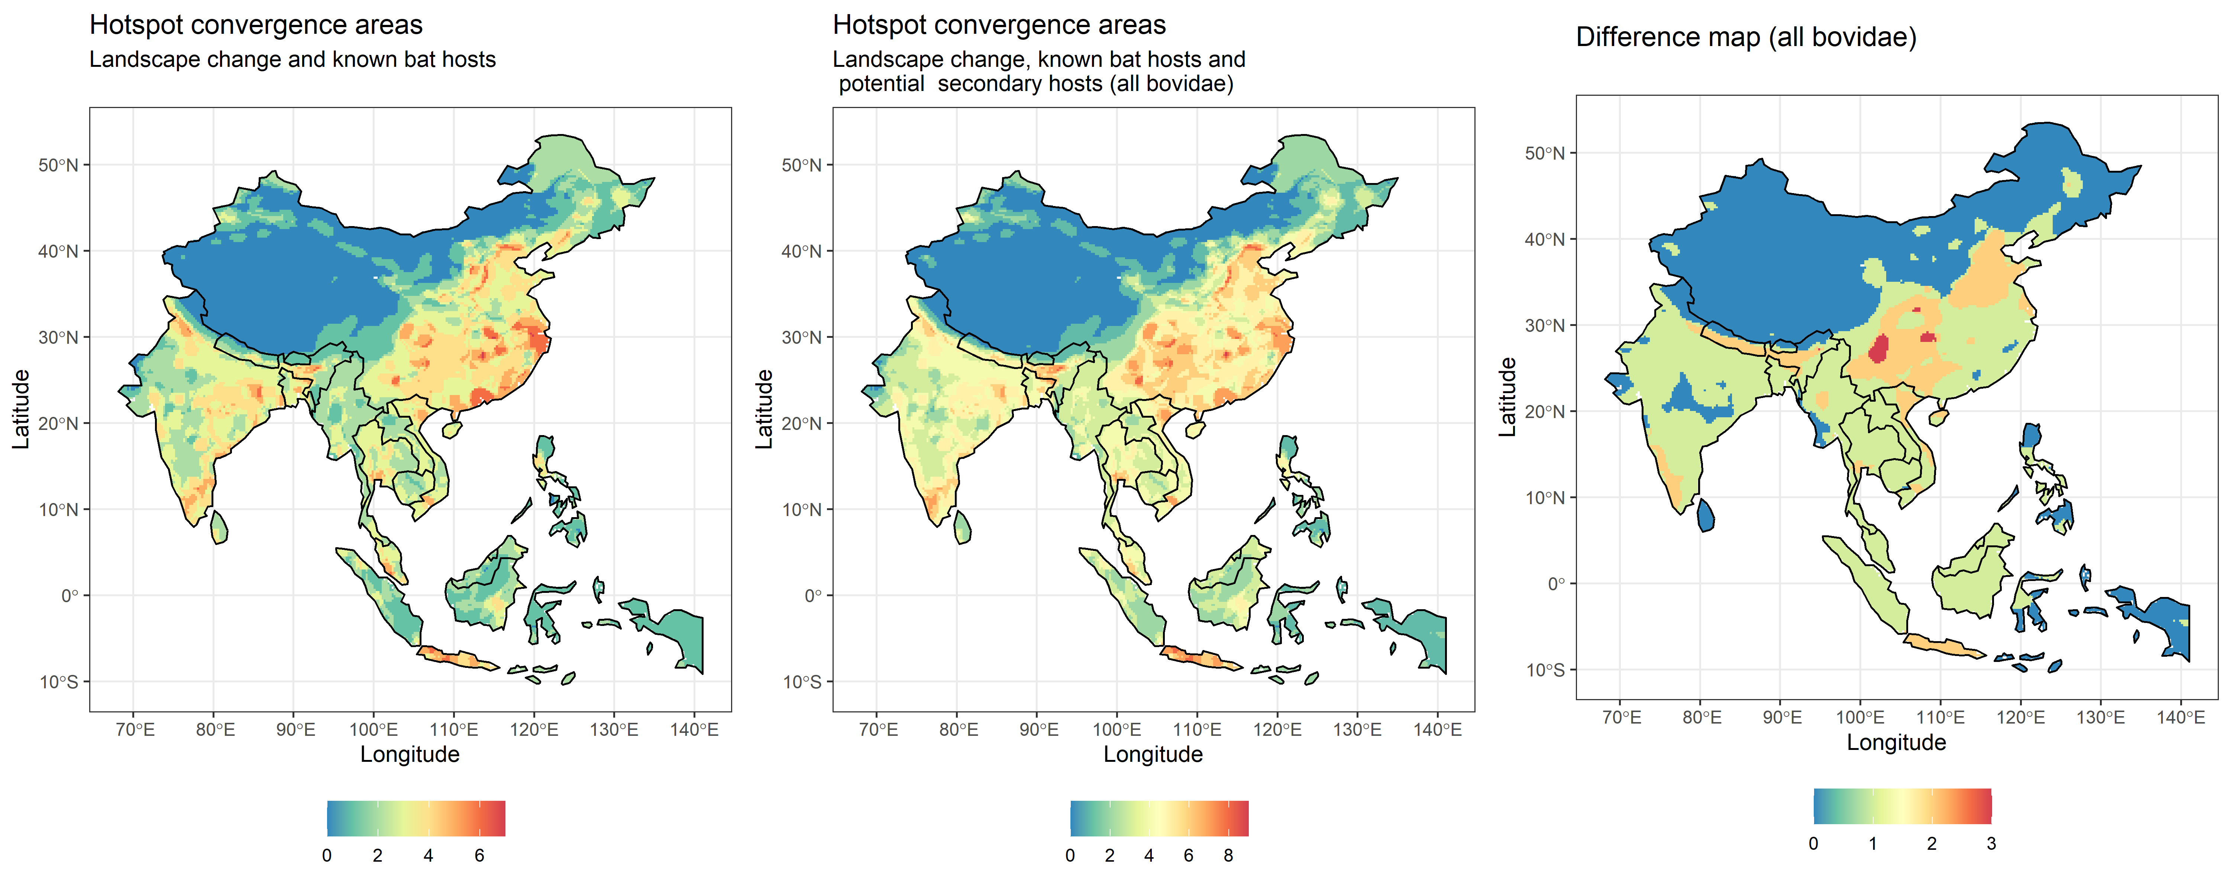
Figure 2

Slide 5
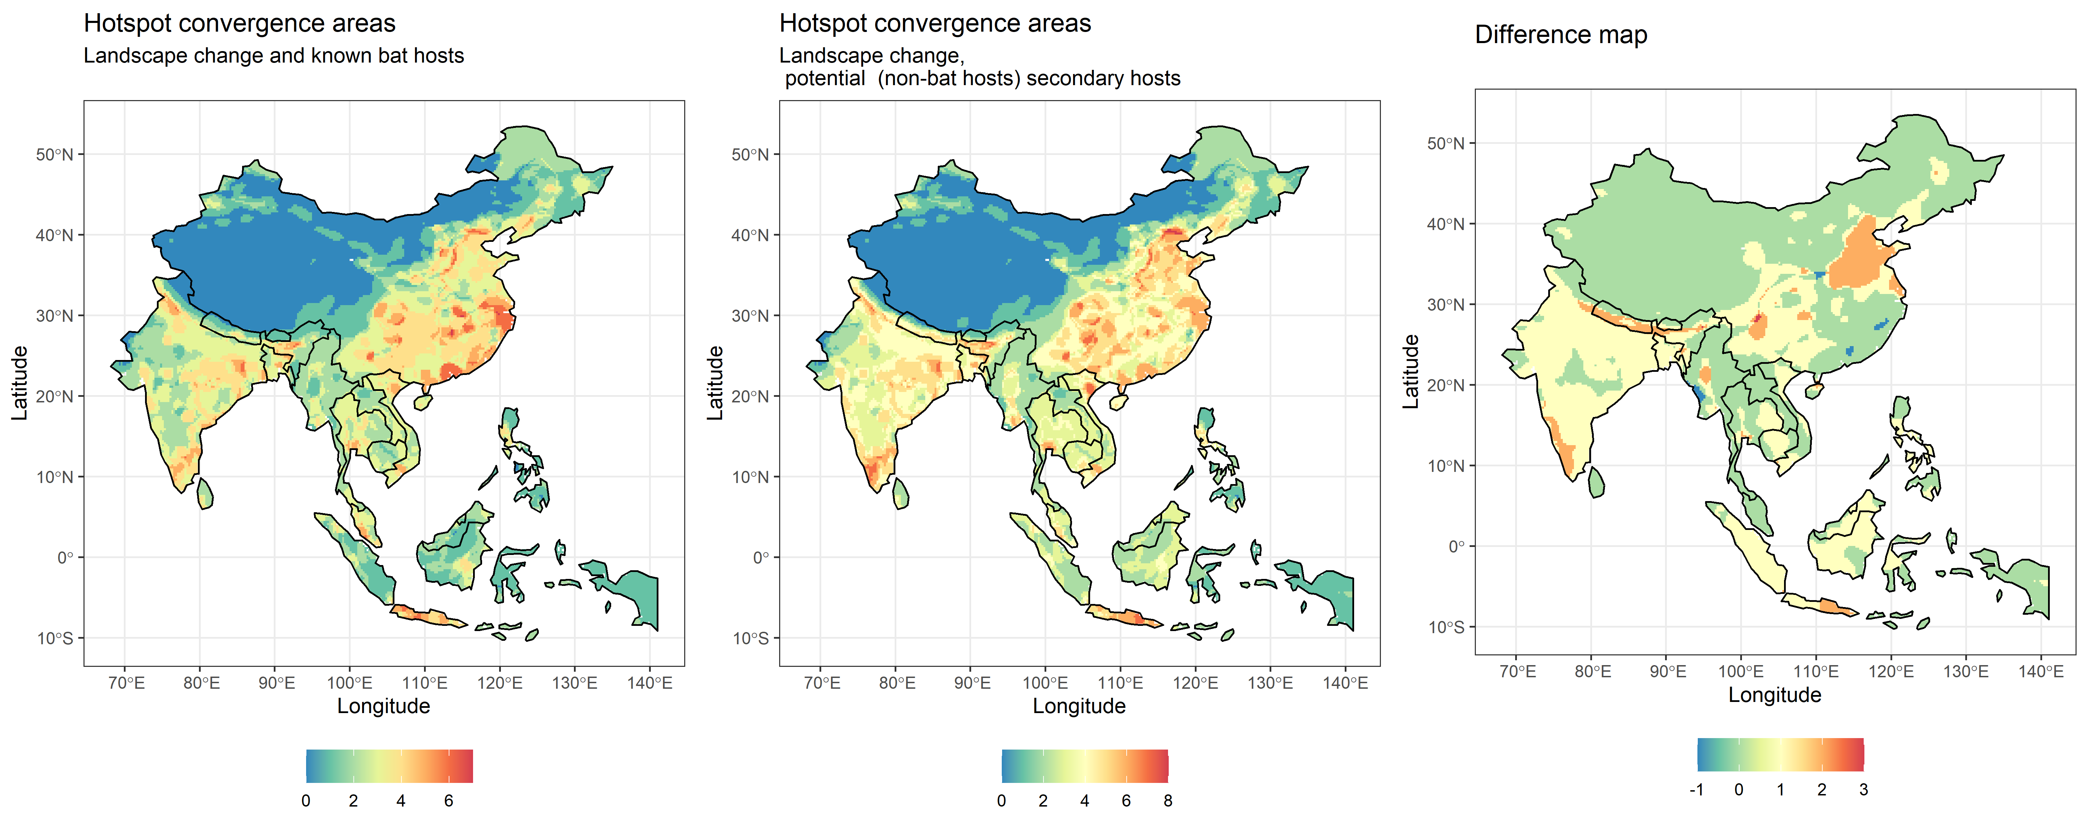
Figure 2

